Slide 1
JOHARI WINDOW

Slide 2
Johari comes from Joseph Luft (1916–2014) and Harrington Ingham (1916–1995)
They were psychologists.
They proposed this model in 1955.

Slide 3
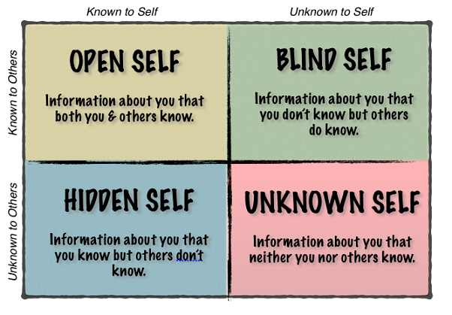

Slide 4
Four windows/quadrants/panes
Open window
Blind window
Hidden window
Unknown window

Slide 5
Open window
The first window is the ‘open’ window.
Actions, behaviors and information known to the individual and known to others.
This information is public and made available through communication and exchanges between the individual and others.
This includes information, facts, skills and attitudes – anything that is public knowledge.
Name, height, physical complexion, hobbies, education, class, branch, etc.

Slide 6
Blind window
Blind: The second one is called ‘blind’ window.
Actions and behaviors known to others, but not known to the individual.
The information can be positive or negative.
Scratching head, shouting, laughing loudly, playing with pen or pencil, being rude to others in public, etc.
You speak excellently, but you are not aware. Your friends will tell you.

Slide 7
Hidden window
Hidden: This information is known to the individual, but not known to others.
This may consist of private information, which the individual chooses to keep hidden.
Feelings, ambitions, dreams, romantic breakups, family problems, misunderstandings in the family, sensitive opinions about people, issues.
We do not share out of fear of negative reaction.
Once the individual trusts others they may choose to reveal some of their hidden information.

Slide 8
Unknown window
Unknown: This is the unknown window.
This includes information, skills, behaviors, etc. that are unknown to the individual and to unknown others.
This includes subconscious information that no one is aware of such as early undiscovered talents , childhood memories, etc.
You are an engineering student. You do not know whether you can be an athlete or a musician! Others too do not know about your athletic or musical skills!

Slide 9
Goal of the Johari window
Increase the size of the Open window without disclosing too much personal information about yourself.
Decrease the size of the Blind, Hidden window.
Increase the Unknown window.

Slide 10
Solutions
How to increase OPEN window---
Talk, reveal your feelings, opinions
Reveal. Let people know your hobbies, fears, likes/dislikes! But don’t reveal too much!
How to decrease BLIND window–
Ask for feedback.
Ask people what areas to improve.
Ask what drawbacks you have.
Be humble and improve.

Slide 11
Solutions
How to decrease HIDDEN window:
Don’t be too secretive.
Mingle with people.
Reveal, share your feelings, opinions, happiness or unhappiness, emotions with others.
Don’t be too secretive or sly.
How to increase the UNKNOWN window:
1. Experiment new things
2. Try new ideas, self-discovery.

Slide 12
https://www.google.com/search?q=johari+window+ima
https://explorance.com/blog/discovering-blind-spots-in-360-degree-feedback-with-the-johari-window/

